Slide 1
Midterm Prep Session #2

Slide 2
Outline
Concepts
Question Period. Now is the time to ask about anything on the midterm practice that doesn't make sense (rewrite in a brief way)
Practice questions (3?)
  Specify to get into groups? Beforehand?
  Put on a timer on the board???
  Do we want to do what we had last time?

Slide 3
Overview
What are these basic concepts
  Arrays
  Inheritance
  Encapsulation
  Statics/Abstracts

Slide 4
Arrays
What do you know about arrays?

Slide 5
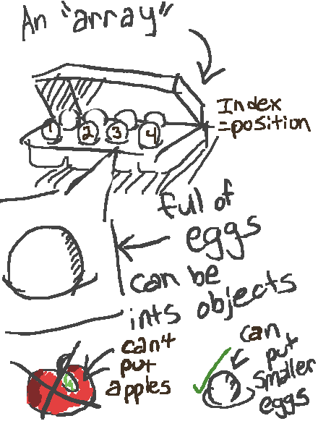

Slide 6
Other notes on arrays
objectName.method();
Equivalent to:
listOfObjects[i].method();
Casting tells explicitly that children are children
not parents. Children can stand in the place of
parents but parents cannot become children.

Slide 7
Inheritance
What do you know about inheritance?

Slide 8
Here’s a way to think of it

Slide 9
Encapsulation

Slide 10
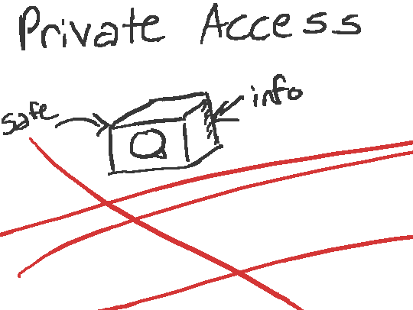
Access Privacy/Protected/Public
Different accesses creates barrier, but also allows to create easy error checkers.
Scope is key to keep in mind.
Ask yourself:
- What class am I in?
- What am I trying to get?
- Where am I trying to get it from?
Do I have the right to access it (Public, Private, Protected)?

Slide 11
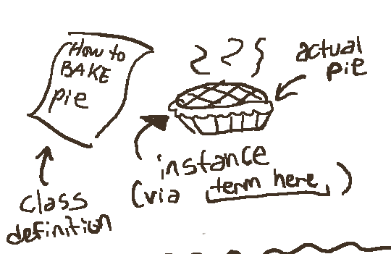
Class definitions are like recipes. When called upon it will create an object via its
[insert term here.]
Unless it’s static (which is special) an object must be [insert term here] in order to do anything with that class.
You can’t eat a pie that isn’t there.

Slide 12
Statics?
What in the world are these? Do you know?

Slide 13
Static Class Example: Math class
(the Java class!)
Visualize Math being a physical object…does
that make sense?
Statics don’t need initialization, they aren’t
objects. They float around in a more abstract kind
of realm.

Slide 14
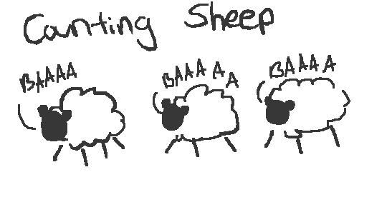
Static Variable Example

Slide 15
First Example
Public class Zoo{ // A few lines below the part beside
public Animals [ ] zoo; //Anywhere in class Zoo
public Zoo (int size){ public void static main (String []args){
zoo = new Animals[size]; Zoo Calgary = new Zoo(10);
int mid = size/2; for (int i = 0; i < 10; i++){
for (int i = 0; i < mid; i++){ System.out.println(Calgary.zoo[i].toString());
zoo[i] = new Monkey(); }
}
for (int j = mid; j < size;){
zoo[i] = new Elephant();
}
}

Slide 16
Associated questions
What are Monkeys and Elephants to the Animal class (parents, no relation, other…)?
Do they implement or extend the Animal class?
Suppose:
Monkey.toString() returns the string “I am a monkey”
Elephant.toString() returns the string “I am in the room.”
Animals.toString returns “This is an animal.”
What is the output of main (How many lines)?
How would we change this so it prints the monkey strings and the elephant
Strings?
How could we keep count of how many monkeys and elephants there are in the
program?

Slide 17
End Slide
Any final questions
Good luck!

